Slide 1


Slide 2

Domain-Driven Design Patterns in .NET DEV-B211
Dino Esposito
Andrea Saltarello

Slide 3
What we’re REALLY talking about
DDD Analysis Patterns
Ubiquitous language
Bounded contexts
Context maps
Supporting architectures
#1: Domain Model
#2: CQRS
#3: Event Sourcing
Key takeaway
Go beyond Domain Model and move towards CQRS
(related session B313)

Slide 4
DDD Analysis patterns

Slide 5
DDD has two distinct parts. You always need one and can sometimes happily ignore the other.
Valuable to everybody and every project
Analytical
Strategic
Just one originally recommended “supporting architecture”

Slide 6
Conducting analysis using DDD
Ubiquitous language
Vocabulary shared by all involved parties
Used in all forms of spoken/written communication
Bounded contexts
Areas of the domain treated independently
Discovered as you assess requirements and build language

Slide 7
Ubiquitous Language
Words and verbs reflecting semantics of the business
Technical concepts named in a context-sensitive manner
You don’t “delete a record” but you rather “cancel an order”
Ubiquitous Language
Domain
experts
Dev
teams

Slide 8
Ubiquitous language
Nouns and verbs
Referring to key business concepts
Mapping to technical actions
(e.g., cache, security, database)

Slide 9
Scenarios Where UL is Key to Have
Really a lot of domain logic tricky to digest
Ensures all relevant terms are understood
No other term is used to indicate same/similar concepts
Business logic not completely clear
Business is young (startups) and grows with the system
Domain logic being discovered day after day
Excellent tool to make full sense of the “idea”

Slide 10

verb
As a registered customer of the I-Buy-Stuff online store, I can redeem a voucher for an order I place so that I don’t actually pay for the ordered items myself.
noun
Voucher is a business-specific name.
Nobody should ever use synonyms like coupon or gift card.

Slide 11
Bounded contexts
Sometimes, the same term has different meanings when used by different people in a large organization.
When this happens, you probably crossed the invisible boundaries of a subdomain. The business domain you assumed indivisible needs be split.

Slide 12
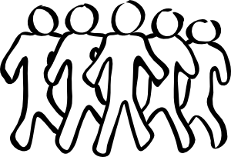
Integrity of the model at risk
Development Team #1
Development Team #2
Area of influence
Area of influence

Slide 13
Each bounded context …
Has its own ubiquitous language
Has its own domain architecture (and model)
Belongs to a context map

Slide 14

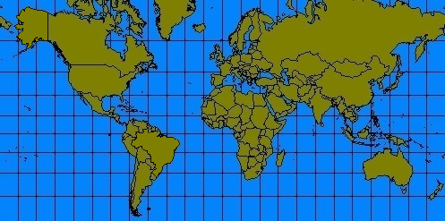
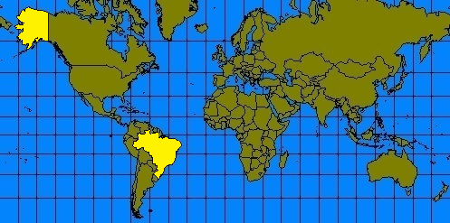
ALASKA
BRAZIL
Is Alaska as large as Brazil?
Brazil is 5x larger than Alaska.
Is the map just wrong?
Just a Mercator projection map.

Slide 15
Angle between courses and all parallels is always constant!
To go from A to B just follow the angle—easy to draw with protractors

Slide 16
Weather
Forecasts
(external)
Core Domain
u
u
Customer/Supplier
u
Customer/Supplier
d
d
d
Anti-corruption layer
Club site
Backoffice
Partner
u = upstream
d = downstream
partner = mutual dependency but no shared code
customer/supplier = upstream rules, but teams talk
ACL = additional layer hiding to the downstream context any changes implemented at some point in the upstream context

Slide 17
In a nutshell…
DDD is about analysis
DDD provides great tools for domain analysis: ubiquitous language e bounded contexts
DDD takes to discover the top-level architecture
Context map
DDD requires supporting architecture(s)
DDD in its original formulation provided a recommended one: Domain Model
Other options available and emerging today: CQRS, functional models, CQRS+events
DDD ≡ Domain Model

Slide 18
Supporting architectures
Multi-layered (-tiered)
Client/server (2-layer/tier)
Domain Model
CQRS B313 tomorrow
Event Sourcing B313 tomorrow

Slide 19
Why Aggregates
A way to ensure business consistency
Transactional consistency only, within the domain
Work with fewer and coarse-grained objects
Aggregate root entity to encapsulate all child entities
Less entity-to-entity relationships to care about
An aggregate may simply be logical grouping
Sometimes wrapper class helps protecting from outsider access
“An aggregate is a cluster of associated objects that we treat as a single unit for the purpose of data changes.” –E. Evans

Slide 20
CQRS to the rescue…
Tomorrow…
h17.00 8.0 B1

Slide 21
DEV Track Resources
http://www.visualstudio.com
http://blogs.msdn.com/b/developer-tools/
http://msdn.microsoft.com/vstudio
visualstudio
@visualstudio
visualstudio

Slide 22

Resources
Learning
Sessions on Demand
Microsoft Certification & Training Resources
http://channel9.msdn.com/Events/TechEd
www.microsoft.com/learning
TechNet
Developer Network
Resources for IT Professionals
http://microsoft.com/technet
http://developer.microsoft.com

Slide 23
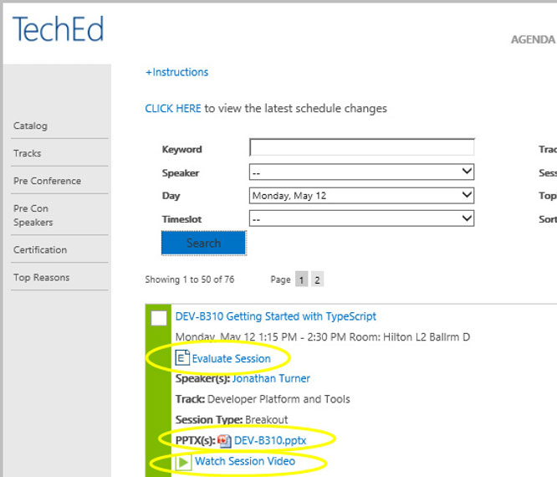
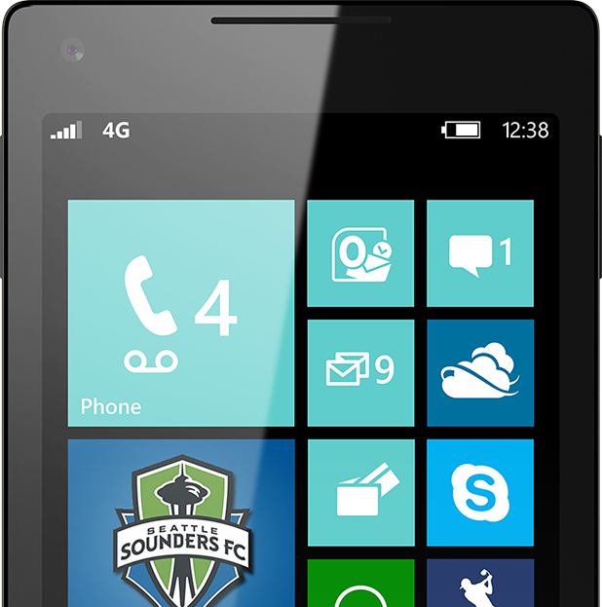
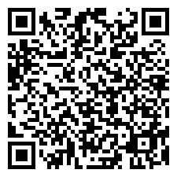
Please Complete An Evaluation Form Your input is important!
TechEd Schedule Builder
CommNet station or PC
TechEd Mobile app
Phone or Tablet
QR code

Slide 24
Evaluate this session

Slide 25


© 2014 Microsoft Corporation. All rights reserved. Microsoft, Windows, and other product names are or may be registered trademarks and/or trademarks in the U.S. and/or other countries.
The information herein is for informational purposes only and represents the current view of Microsoft Corporation as of the date of this presentation. Because Microsoft must respond to changing market conditions, it should not be interpreted to be a commitment on the part of Microsoft, and Microsoft cannot guarantee the accuracy of any information provided after the date of this presentation. MICROSOFT MAKES NO WARRANTIES, EXPRESS, IMPLIED OR STATUTORY, AS TO THE INFORMATION IN THIS PRESENTATION.

